Slide 1
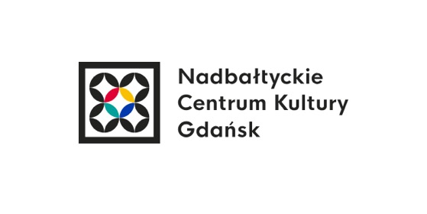
Creative Waves – Baltic Sisterhood for Change GDANSK September 26, 2022

Slide 2
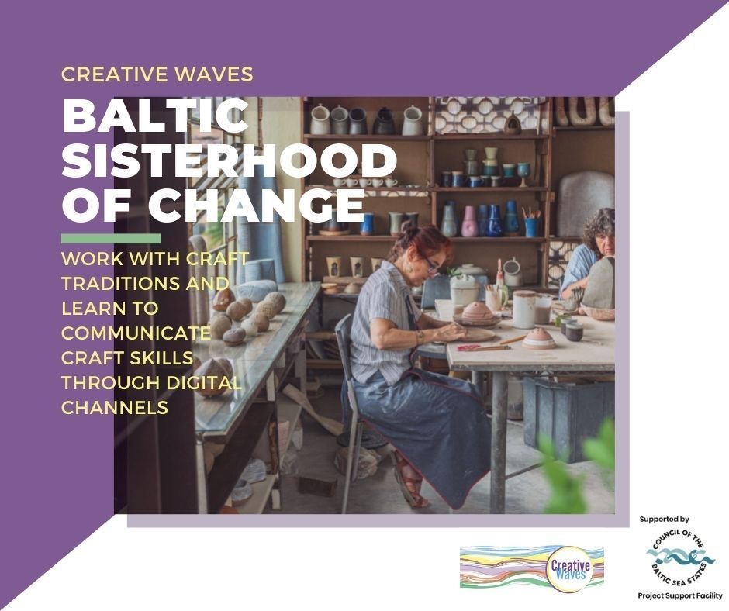

Slide 3
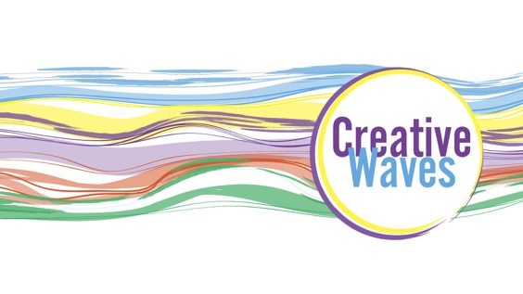
PARTNERS
Intercult Stockholm, Sweden – lead partner
Baltic Sea Cultural Centre Gdańsk, Poland;
Euroregion Baltic ERB (Association of Polish Communes);
Estonian Women’s Studies and Resource Centre ENUT;
Team of Activists from Kaliningrad Region/Russian Federation

Slide 4
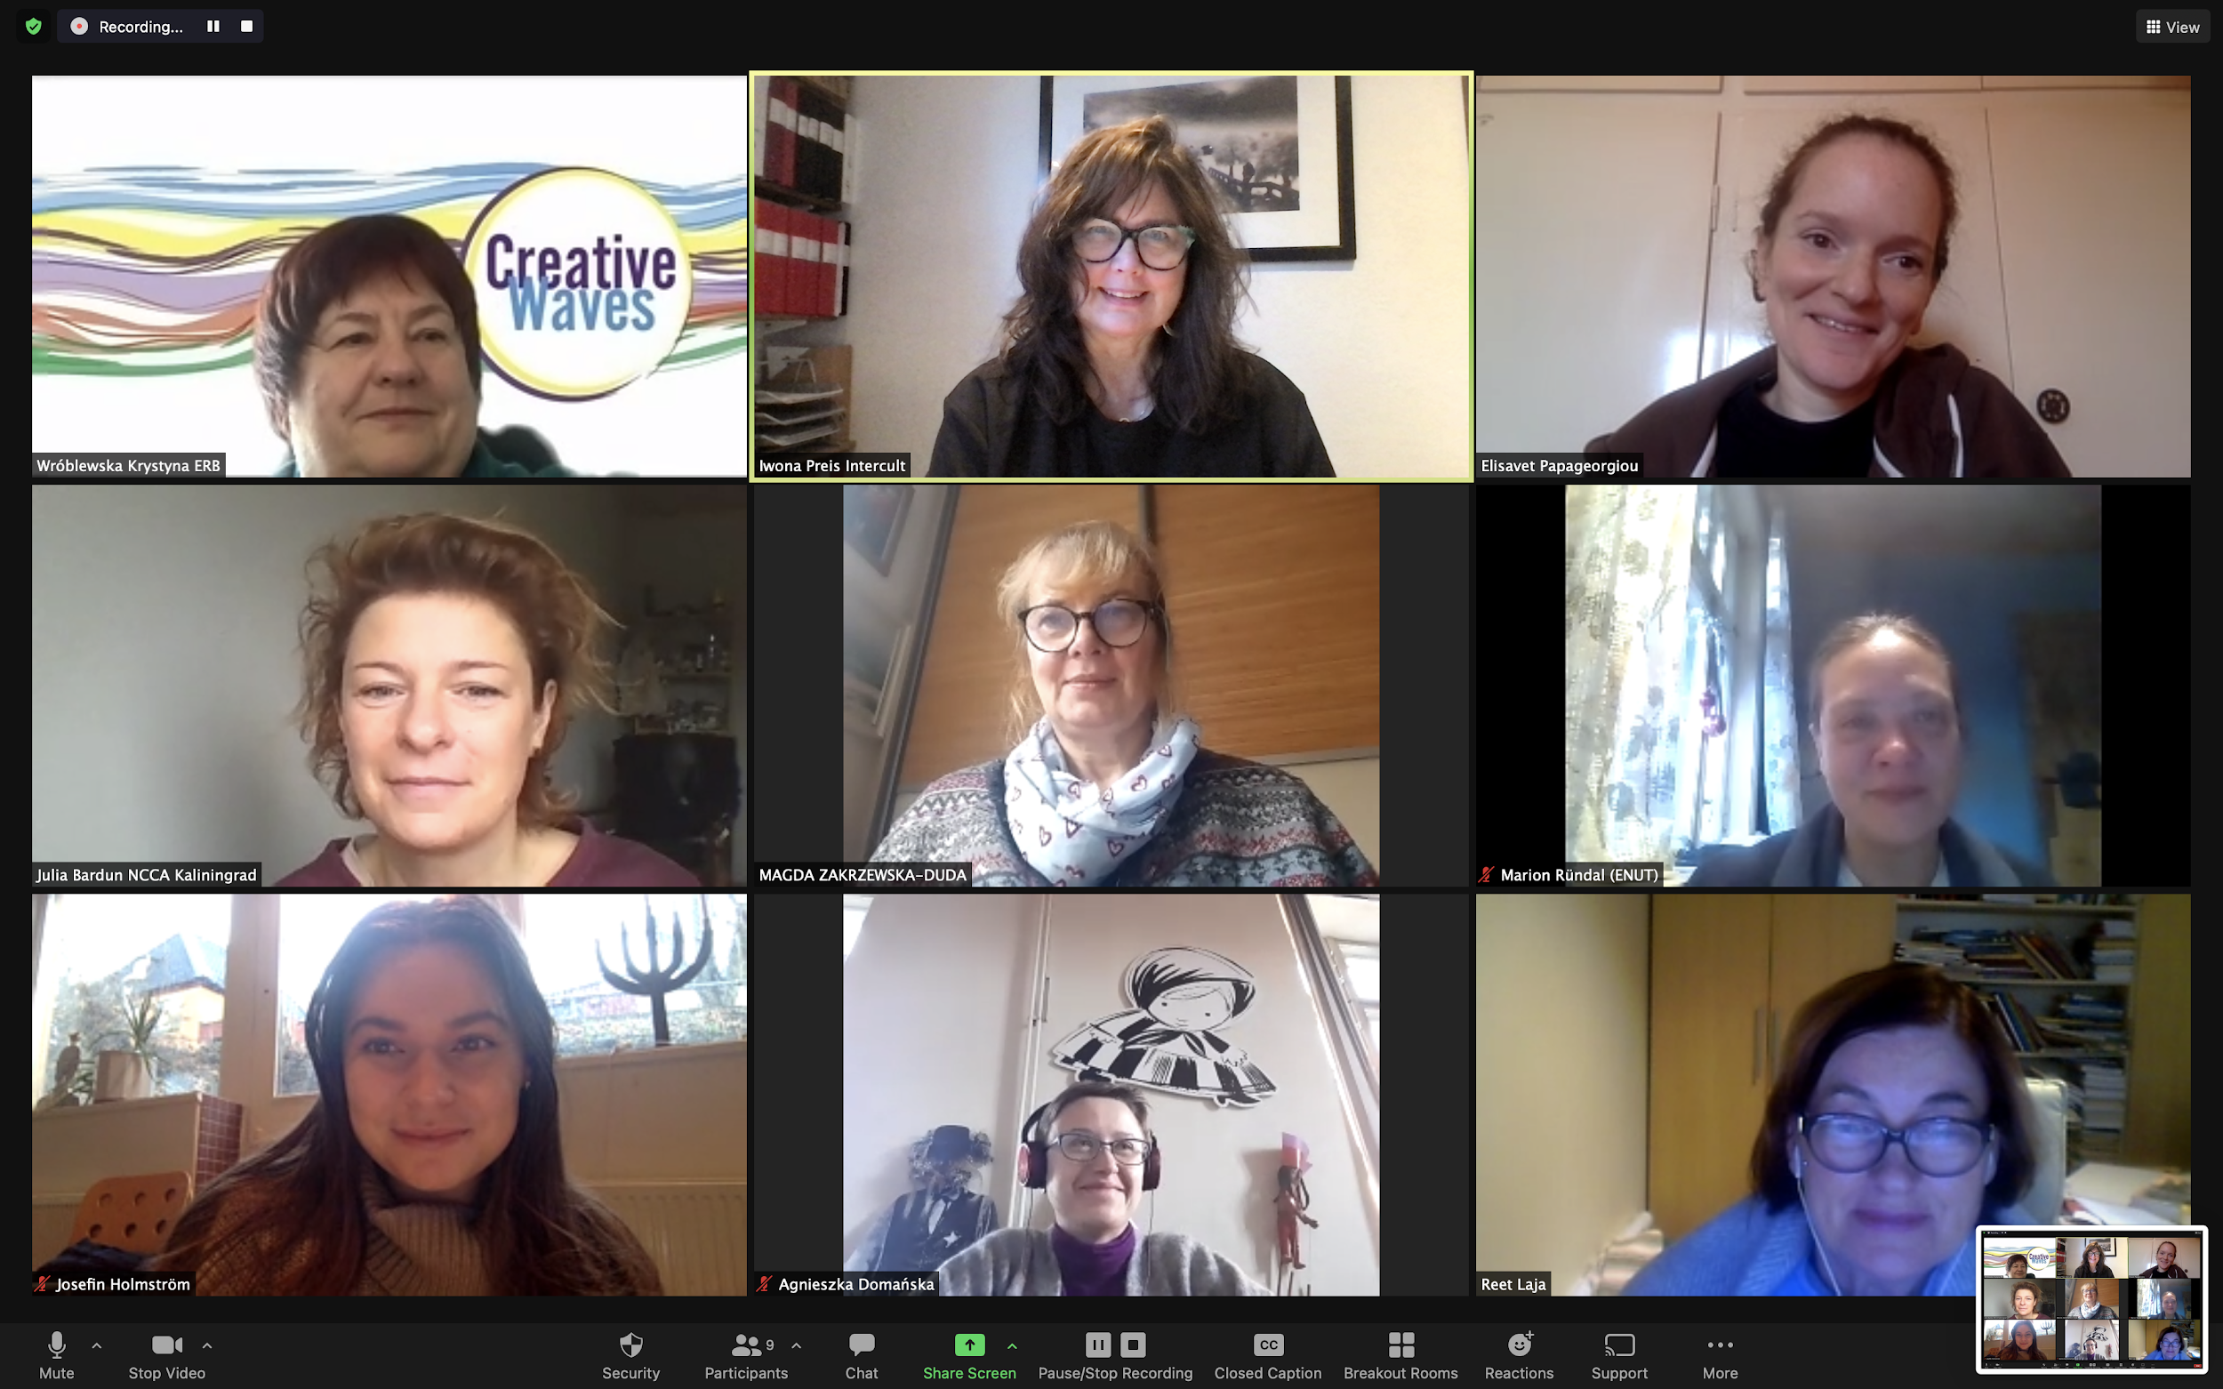

Slide 5
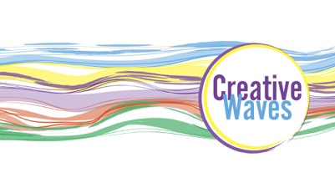
PROJECT GOAL
Empower women – especially from smaller, more remote places
Provide women with skills – to help function in digital world and be more self-assured and entrepreneurial;
Promote women creatives;
Bring together traditions and crafts (intangible cultural heritage) and new technologies;
Help society become stronger and more resilient;
Create feeling of Balticness;
Promote / inform on EUSBSR, SDGs and European Green Deal

Slide 6
PROJECT ACTIVITIES
Creative activities such as: embroidery, pottery, herb gathering, story-telling, textile painting of roses, herb jewelry ;
International webinars;
Physical meetings and workshops with creative women, digital and social experts in partner regions:
Online meetings – partners to exchange experience and proceed with the project

Slide 7
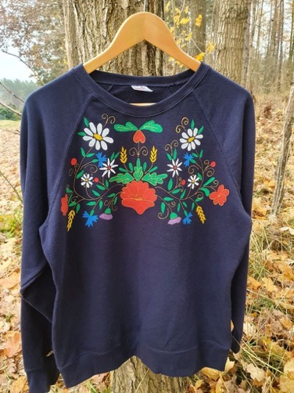
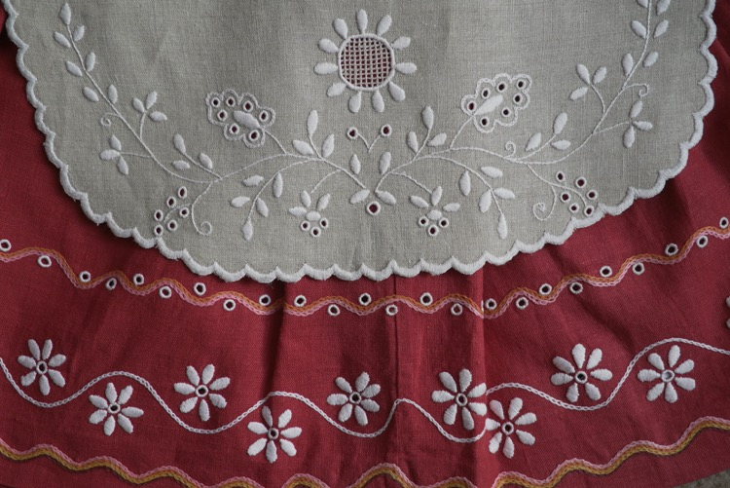
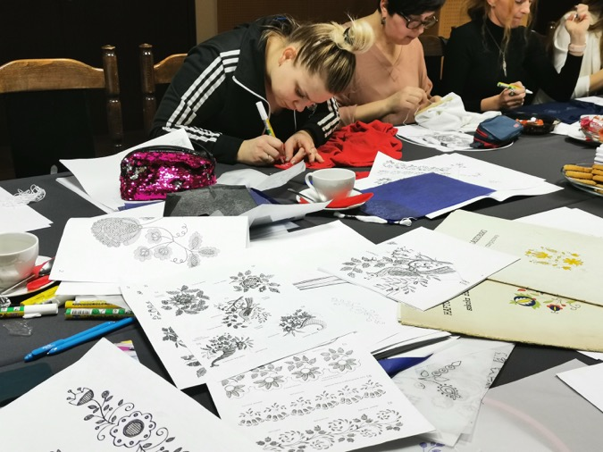
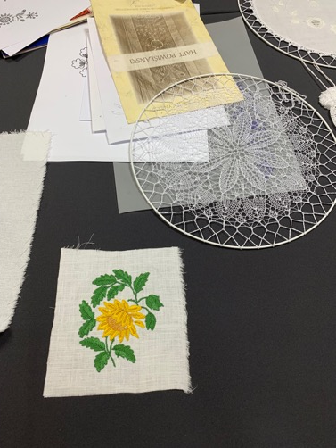
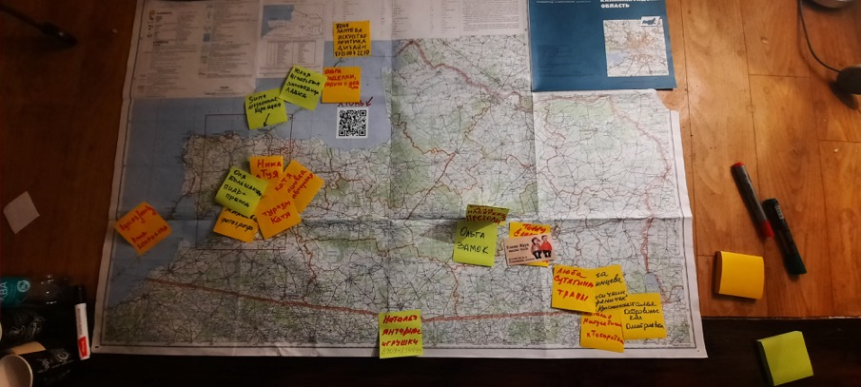
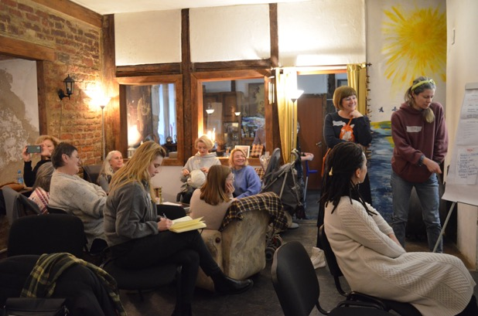
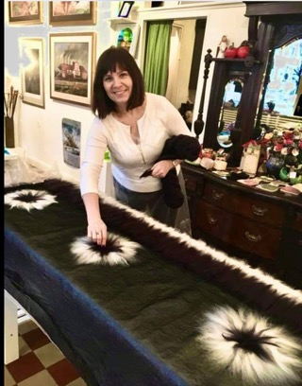
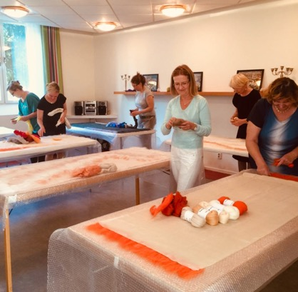

Slide 8
PROJECT OUTCOME
Networks of creative women – both locally and in the BSR;
Stronger society;
Creation of local communities
Crises (like COVID) preparedness;
Survey made by ENUT;
Better awareness of EUSBSR, SDGs, European Green Deal, Baltic intangible heritage;
Preservation of traditions and crafts
Tool kit (recommendations) for further use;

Slide 9
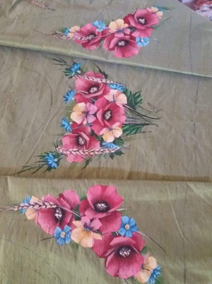
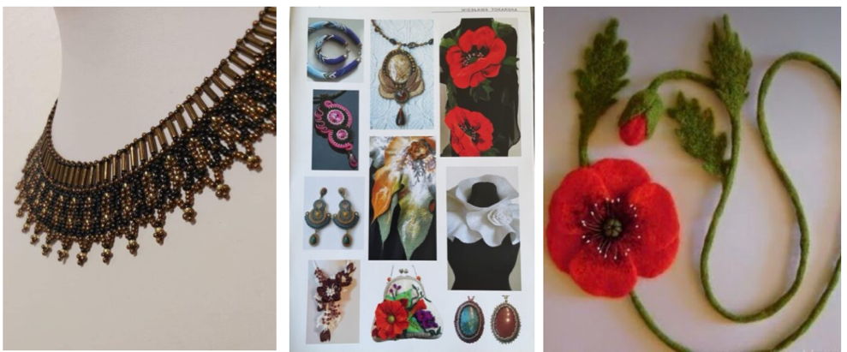
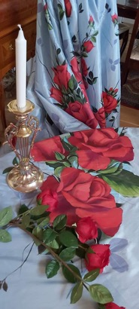
STOCKHOLM ACTIVITIES 2022
Introduction & inspirational gathering (26th February 2022)
Workshop 1: Textile design with folk inspirations- roses (26 March)
Workshop 2: Wool jewelry design with folk inspirations (23 April)
Workshop 3: Digital skills, social media (21 May)
Workshop 4: Digital skills- designing in PhotoShop (3 Sept)

Slide 10
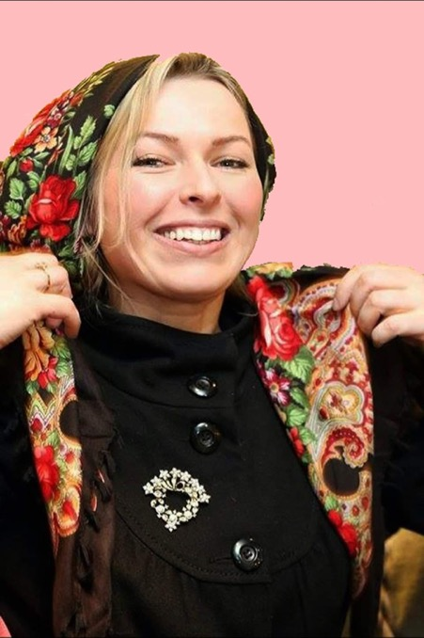
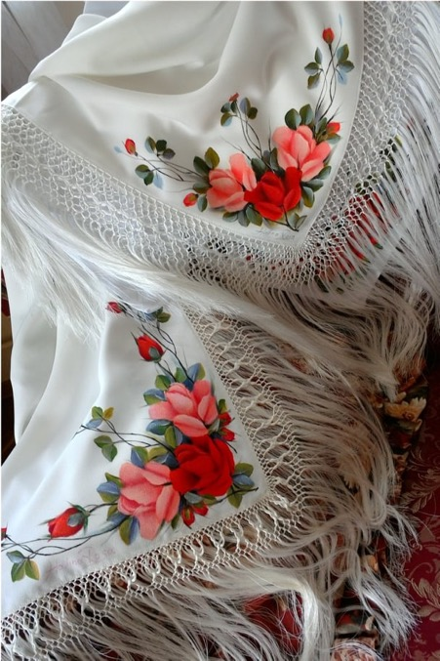
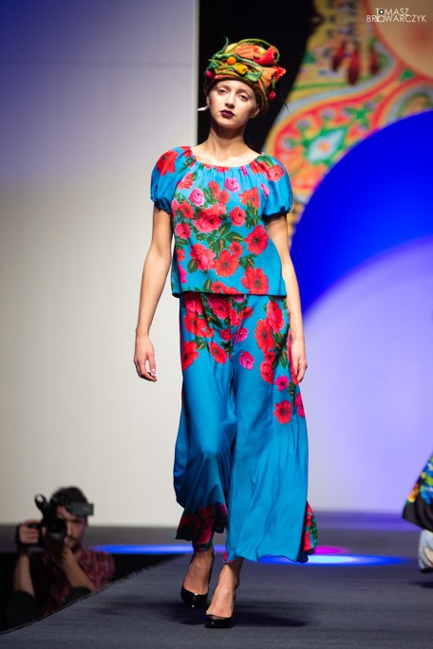
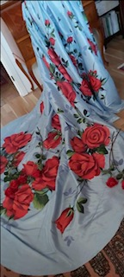
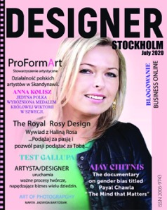
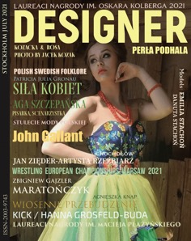
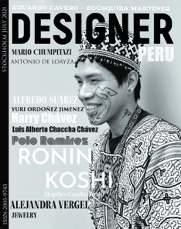
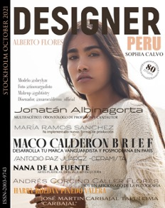
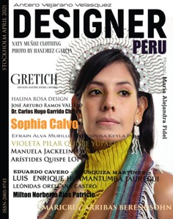
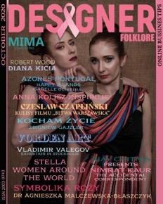
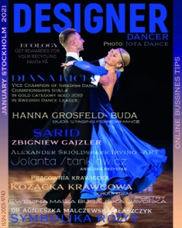
HALINA ROSA

Slide 11
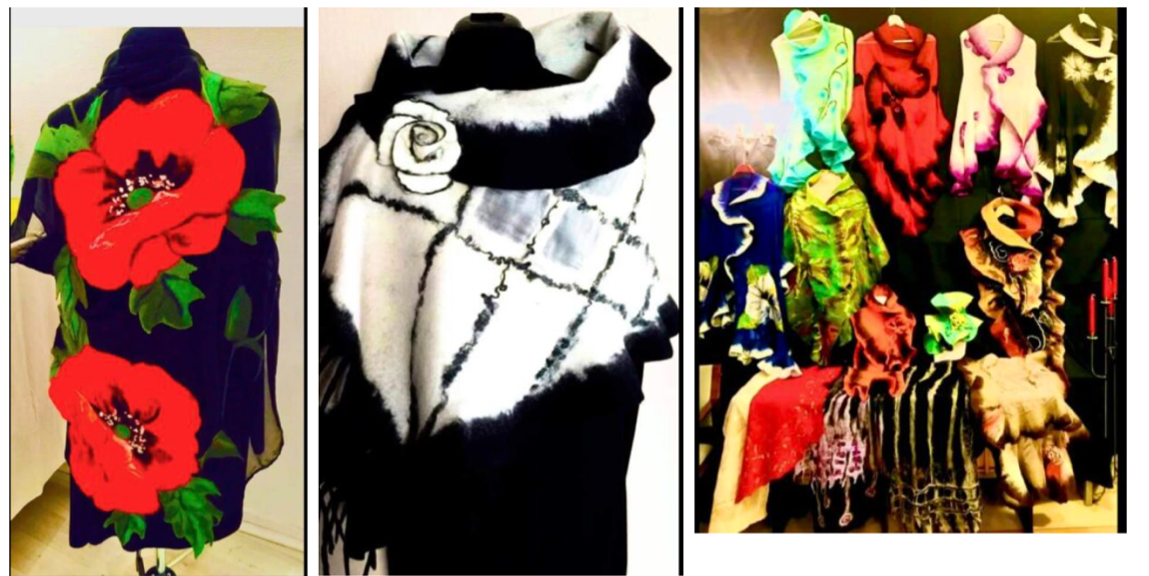
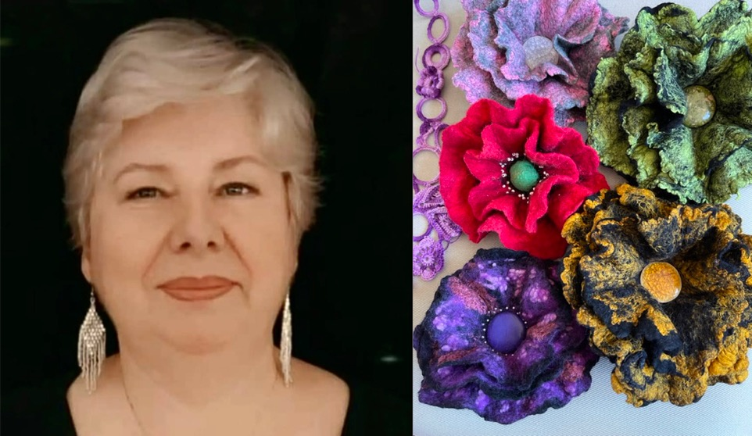
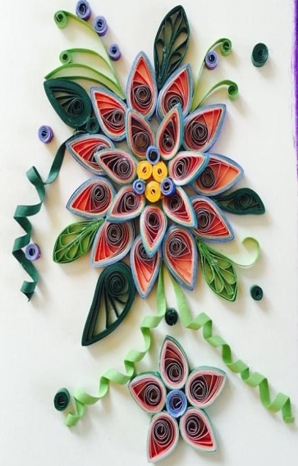
WIESLAWA TOKARSKA

Slide 12
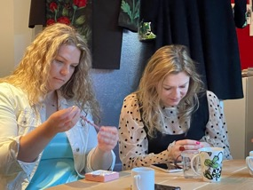
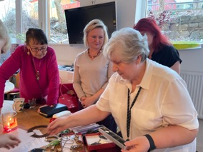
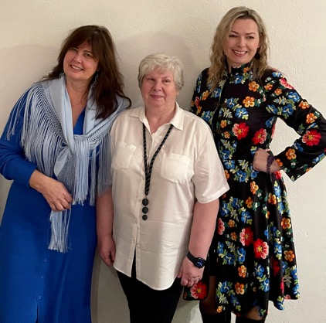
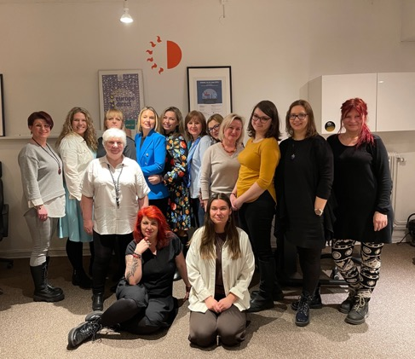
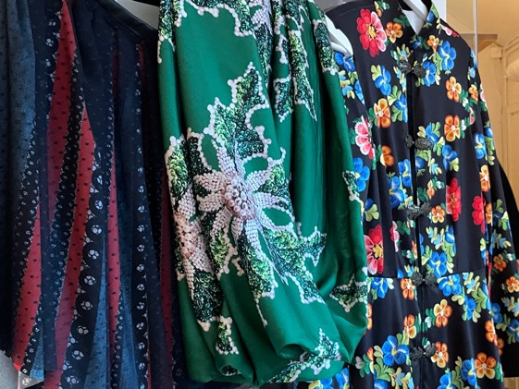
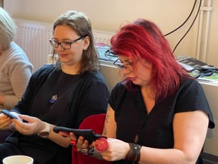
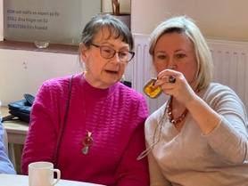
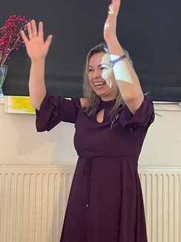
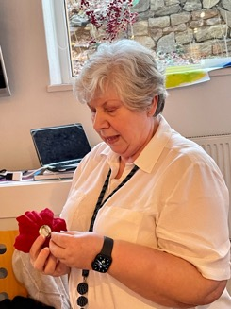
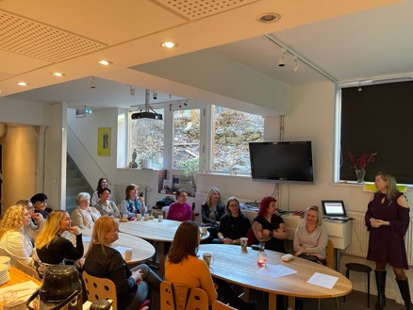
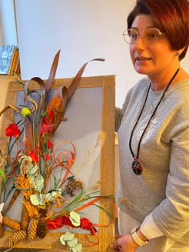
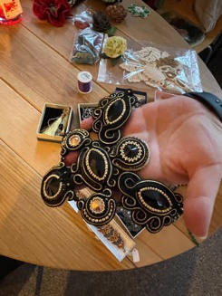
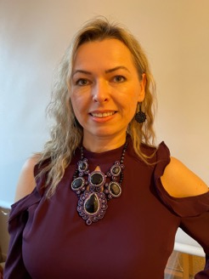
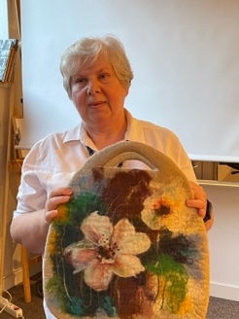
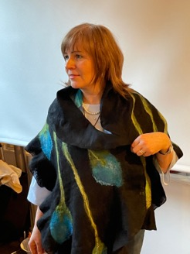
Intercult – Gathering - 26 February in Stockholm

Slide 13
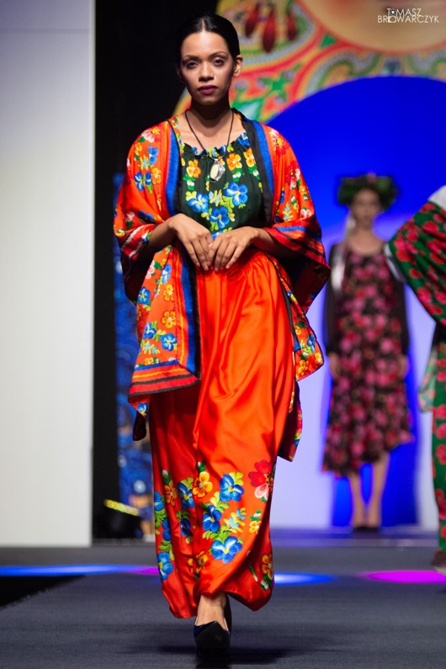
Workshop 1: Textile design with folk inspirations
Roses as pattern. Participants during the workshop used unique materials, traditional patterns and methods for crafting hand painted textiles and create their own creative item.
Artistic leader: Halina Rosa
Polish folk artist, painter and designer that lives in Stockholm;
Designs patterns from the provincial regions in Poland and Sweden;
Ambassador for Business Women for promoting creativity, entrepreneurship in the world;
Co-author of the second edition of Kinga Langley’s book “BUSINESS INSPIRATIONS WITH POLISH WOMEN IN THE WORLD”;
Ambassador of World Polonia Heritage;
Editor in Chief of the DESIGNER magazine;
Founder of the Foundation of Supporting Culture and International Cooperation named Halina Rosa

Slide 14
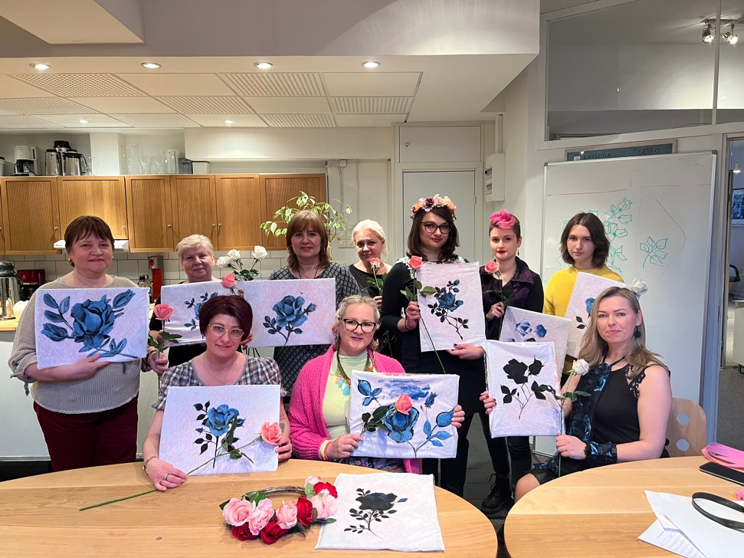
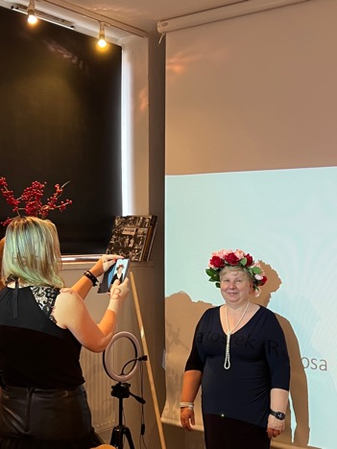
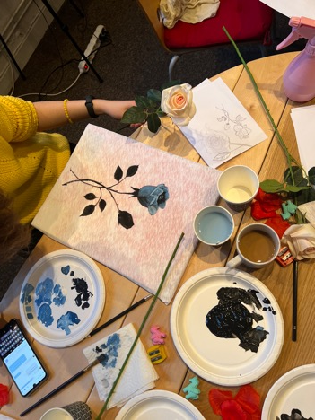
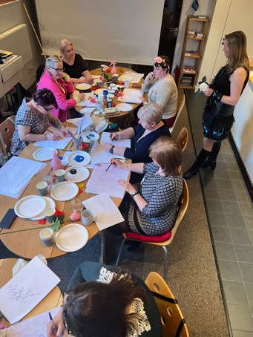
Intercult – Workshop 1 - 26 March in Stockholm

Slide 15
Workshop 2: Wool jewelry design with folk inspirations
Participants used unique material like felt, traditional methods for crafting handmade jewelry that is made with wool and create their own creative item.
Artistic leader: Wieslawa Tokarska
Polish folk artist that lives in Stockholm;
Trained seamstress; for 20 years she has had her own sewing studio for women’s clothing in Poland
Combines sewing with traditional craft techniques and new designs
Teaches women in Poland and in Sweden craft techniques, e.g. how to work with felt, silk, lace, embroidery, stones and pearls, teach how to make scarves in felt and silk from delicate Australian merino wool, blouses, jackets and bags
Creation of different types of jewelry

Slide 16
Intercult – Workshop 2 - 23 April in Stockholm

Slide 17
Workshop 3: Digital skills, social media
Participants trained on creating posts on Instagram and business page on FB
Part one: Pixie Hård av Segerstad and Josefin Holmström from Intercult in Stockholm, shared information on the safe use of digital platforms and how to use different social media channels (Facebook, Instagram) marketing and logo tools.
Part two: To develop the participants’ digital skills – the participants had the chance to create their own social media marketing, with guidance from leaders, that promotes their artistic handcrafting item.

Slide 18
Intercult – Workshop 3 - 21 May in Stockholm

Slide 19
Workshop 4: Digital skills, training in PhotoShop
Participants learned how to transfer a hand painted pattern to PhotoShop and make an own design for textile print .
3 September 2022 Stockholm
Led by Halina Rosa

Slide 20
Kaliningrad
Notes:
Partners - team of independent activists/curators with diversified background - sociologist, city activism, environment projection and education, gender issues, botanivcs, culture management, modern art, etc.
Target groups: women living in periferal, remote places: small towns and villages, less popular parts of Kaliningrad), women involved in traditional cultural practices - trying to look at them against the modern context, women involved in creative activities, interested to work with material and intangible cultural heritage
Activities - goals: to make participants interested in regional cultural assets, cultural heritage (cooking, weaving, herb gathering, gardening) storytelling on the region’s history, bringing together cultural activities with contemporary social needs and innovative digital tools

Slide 21
Kalinigrad workshop 1
Notes:
Czerniakhowsk - 26 persons from different small locations
professional background: local gastronomy products, jewellery, ceramics, textiles, photography, modern art, production of souvenirs (wood, amber - local materials), ecology, tourism organisations. Both professionals and just starting

Slide 22
Kalinigrad workshop 2
Notes:
Kurionian Split - workshops on methodology and practicies related to organisation of intergenerational dialogue in order to protect, preserve and interpret the local heritage and pass the knowledge on it to the younger generations.
35 participants from several small areas

Slide 23
Kalinigrad workshop 3
Notes:
Romnicka Forest - workshops mainly on how to understand natural environment, ecosystem, material and intangible heritage which can be the basis for business and creative activities
21 participants from local small towns and villages

Slide 24
Baltic Sea Cultural Center Gdansk

Slide 25
Baltic Sea Cultural Center Gdansk Workshop 1 – White Embroidery

Slide 26
Baltic Sea Cultural Center Gdansk Workshop 2 – Design Thinking- New Application

Slide 27
Cultural heritage meets new technologies- international webinar 28 February 2022 Craft as a Making Process
Agnieszka Jacobsson- Cielecka is a curator and design critic. In her work, she connects different fields of design. As a curator, she creates and organizes exhibitions and programmes. She also writes about design, comments on phenomena and follows trends. As one of the most important promoters of young designers, she is the curator of numerous presentations of Polish design in museums and festivals in Europe and Asia. She is a member of programme boards and juries of many Polish and foreign festivals and competitions and she is the Dean of the Design Department at SWPS University in Warsaw and the co-author of the curriculum at the School of Form
Notes:
Dr. Agnieszka Jacobson - Cielecka – Dean of the Designer Department of SWPS University in Warsaw,
Co-curator of the curriculum at the School of Form;

Slide 28
Cultural heritage meets new technologies- international webinar 28 February 2022
Making and Telling Interactive Stories and Games for/about Cultural Heritage
Lissa Holloway-Attaway, PhD, is an Associate Professor in Media Arts, Aesthetics, and Narration in the Division of Game Development at the University of Skövde, Sweden. She teaches within the games education, and she is the leader of the GAME (“Games, Arts, Media, Experience”) Research Group at the university. She is involved in developing projects and research at the intersections of arts, humanities, and digital technology and she explores technological interventions in a range of cultural contexts. Her current research is focused on emergent media (AR/VR/MR), experimental digital storytelling forms, digital cultural heritage games, feminist perspectives to support diversity and inclusion.
Notes:
Lissa Holloway – Attaway, PhD – Associate Professor, Media Arts, Aesthetics and Narration; Media, Technology and Culture (MTEC) Research Group Leader;

Slide 29
Estonian Women’s Studies and Resource Centre ENUT
Webinar 6 September 2022
Women empowerment Experiences Kenya and Uganda Eve Kislov & Iwona Preis & Marion Rudal

Slide 30
Final Conference Gdansk 25_27 September 2022

