Slide 1
Project’s Creative Waves outcomes
Marion Ründal
ENUT
26.09.2022 Gdansk

Slide 2
The Estonian Women’s Studies and Resource Centre (ENUT, www.enut.ee)
Established in April, 1997
Grassroots, non-profit, non-governmental organization open to the public
First women’s resource center in Estonia and it includes a specialized library on women’s and gender issues
Ariadne's Clew, the only academic journal of gender studies published in Estonia

Slide 3
MISSION
ENUT is committed to promoting the equality of women and men as one of the basic human rights and the general good in all areas of social life.
VISION
ENUT's vision is a civil society based on the equality of women and men, where ENUT plays an important role in connecting the public sector, associations operating in public interests and the private sector to ensure equality, being a gender-related information source and competence center and a promoter of gender studies in Estonia.
Notes:
ENUT is dedicated to the advancement of equality between women and men as a basic human right, and the promotion of general welfare in all spheres of society, in all spheres of life.

Slide 4
ACTIVITIES
The pay gap
Gender-sensitive budgets
Gender and education
Civil society & democracy
Gender equality in working life, reconciling work and family life
Human trafficking and prostitution
Sustainable development & gender equality
Development cooperation projects
Notes:
Georgia, Armenia, Moldova, Ukraine, Belarus

Slide 5
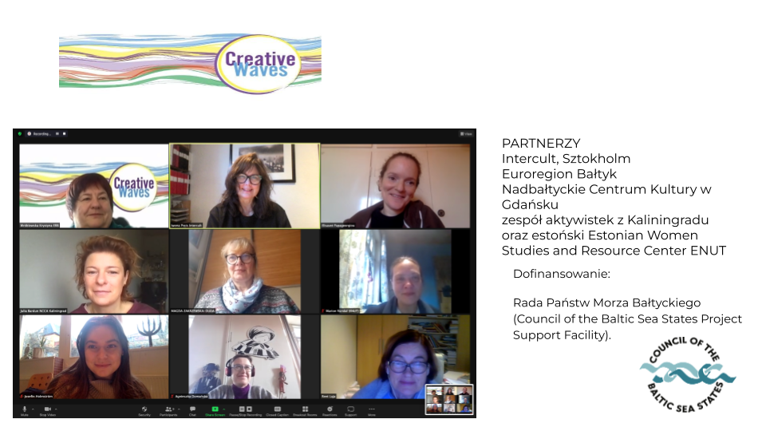
ENUT’s role in Creative Waves
Overall project evaluation
Expertise on gender equality
Empowering women and youth
Prepare a survey
Final report/tool-kit
Notes:
so that the project results and conclusions can be credible on the one hand, and transferable on the other
4. Preparation of survey as basis for research/project evaluation in terms of change
We were always at the meetings, observing the progress, preparing the questionnaires for participants, analyzing and making conclusions, interviewing organisers.

Slide 6
Results
Participants

Slide 7
Main reasons for participation
curiosity to learn something new
to meet new people or to meet with people you already know
to discuss new business opportunities.
Almost unanimously, it was considered important to preserve and develop local traditions.
There was also a unanimous desire to acquire new digital opportunities or to supplement existing knowledge, mostly in order to increase their economic independence.
Notes:
They have had different contacts with tradition so far. Some of the participants have practiced traditional craft for a long time, some of them have not had any contacts so far and some of them have had experience of participation in concerts and exhibitions so far.

Slide 8
Is it possible to make traditional pastimes/art attractive for young generations?
showing and teaching our generations tradition and handicrafts
social media
online training
through conversations and videos
through written articles
integrate embroidery with the things interesting for the youth
special workshops for children
promote fashion for "tradition“
translate it to the topics attractive to the youth e.g. trendy clothes, gadgets
show how you can decorate old clothes so that they can be fashionable again
teach painting embroidery patterns; transfer it to the digital format
Notes:
was answered positively and several ways to involve young people were proposed, such as

Slide 9
What would you suggest how could we encourage the older generation to combine traditional art/craft with the digital means of expression?
Respondents generally had less faith in the abilities of women of the older generation and the desire to combine traditional craft skills with digital expression in this field.
Invitations to meetings and workshops
Computer courses
Possibility of selling their works on the Internet
Cooperation between young and old
And that actually happened!
Notes:
In later workshops wonderful cooperation between young and old happened – young taught older women digital skills and older participants shared their knowledge of traditional crafts. They learned from each other and this is the best kind of learning.
Learning new things makes you more confident

Slide 10
What do terms "women power" and "sisterhood" mean to you? BEFORE
Bond between women
Support
Relationship
Community
Belonging
Solidarity
Helping each other
Learning

Slide 11
What do terms "women power" and "sisterhood" mean to you? AFTER
The feeling that being together we can do great things
Women develop special bonds while acting together
Strong emotional bond
Power women feel when they work together
Self-realization
Strength and creativity
Contact and development
Women's strength flows from relationships with other women
Notes:
In later workshops wonderful cooperation between young and old happened – young taught older women digital skills and older participants shared their knowledge of traditional crafts. They learned from each other and this is the best kind of learning.

Slide 12
Results
Partners

Slide 13
Progress of the project
Covid-19
Harder to find participants
Affected schedule
Support from partners
After awhile participants forgot about Covid, main purpose was to come together, to gain knowledege, to learn, to participate in social connection – it was fun to do something new and exiting
War
Loss of very dedicated project partner
Very emotional situation, lot of tears
We can’t sit and cry, let’s concentrate on something else, diverge our mind from this situation.

Slide 14
Were you satisfied with the progress of your participants? What were the difficult moments working with them?
We are happy with them, such an engaged group
Participants had motivation, were interested
Learning from eachother
They lacked courage and believing in themselves, we provided self-esteem
At first afraid of digital side, but all contributed, helped eacother
They discovered different ways of doing things

Slide 15
Has the project helped to better understand the aspect of gender equality?
We have not really discussed it, but the idea was behind everything we were doing
Important is to create a safe place and share knowledge
We are in process; we are getting more sensitive about that issue
We now understand the long chain of women who supported each other and community
Bravery of everyday, women taught the tradition, upkeeping tradition is very important
We did not talk about the topic but we provided the strength to women
They started to use the name Creative Sisters

Slide 16
How can a project promote gender equality?
Awareness of rights and of equality
Contributes to breaking down barriers that prevent equal participation, benefit from activities, decision making etc
The purpose of the activity is to reduce gender inequality

Slide 17
Gender equality project in phases - planning
Spotting gender inequality
Setting gender equality goals
Engagement, inclusion
The answer to the question "How does action promote equality?
Goals are measurable

Slide 18
Gender equality project in phases - implementation
Gender balance of participants
Analysis of barriers
Communication avoids stereotypes
Considering the needs of the target group
Different capabilities/needs of F&M
Notes:
You can’t force empowerment, you can create conditions for it happening

Slide 19
Thank You!

