Slide 1
CBSS: intergovernmental actions to build communities in the Baltic Sea Region
Aline Mayr, Project Coordinator Regional Identity

Slide 2
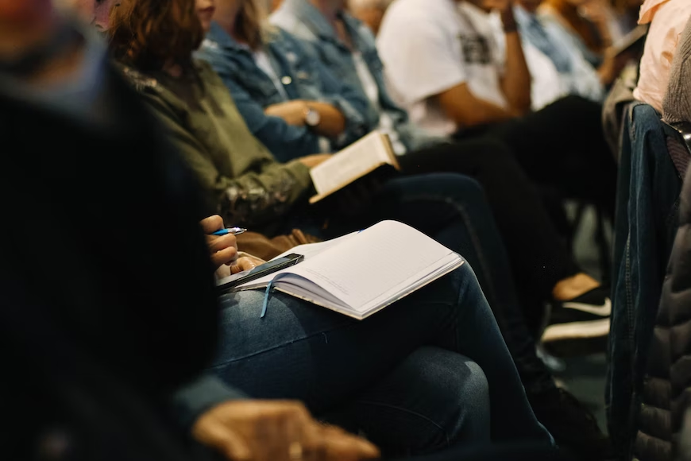
CBSS - Regional Identity
Youth​
Culture​
Higher Education

Slide 3
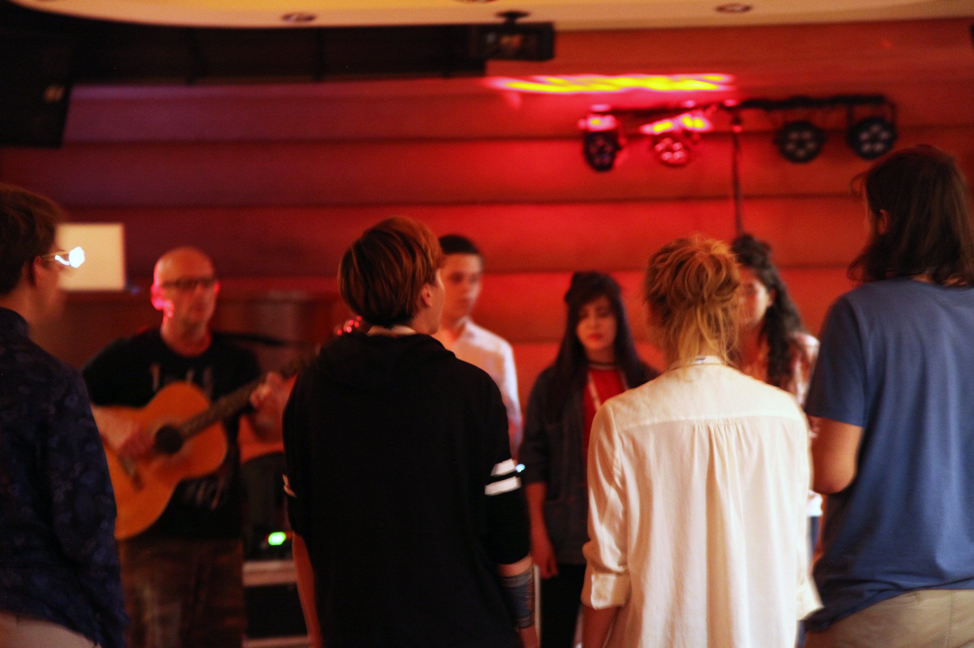
Baltic Sea Youth
Baltic Sea Youth Dialogue
Baltic Sea Youth Camp
Baltic Sea Youth Platform
Baltic Sea Youth Ministerial
Baltic Sea Parliamentary Youth Forum
Baltic Sea Region Youth Forum

Slide 4
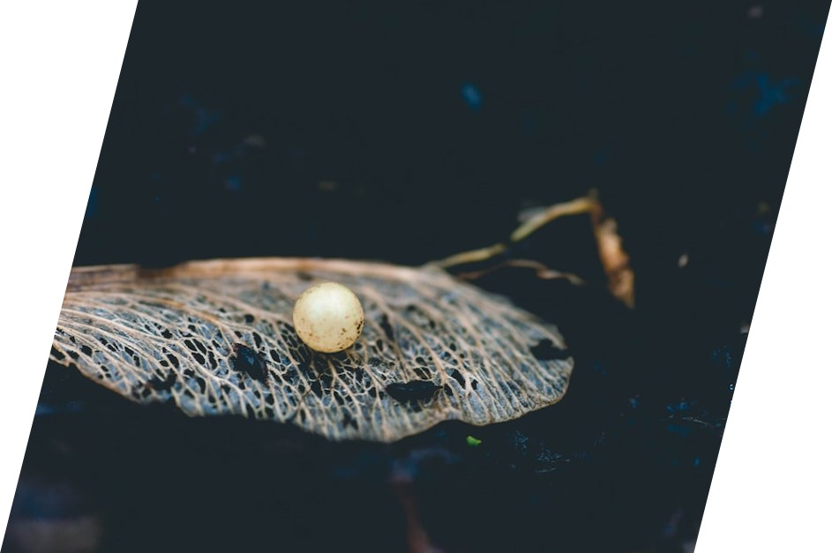
CBSS Culture activities
Baltic Sea Region Cultural Pearls
Baltic Sea Youth – Culture Working Group

Slide 5
Ideas for the future
Baltic Sea Youth cult
(BSY declaration 2022)
Baltic Sea Cultural Roads
(BSY declaration 2020)
Baltic Sea Crocodile Festival
(BSY declaration 2019)

Slide 6
Thank You!
Aline Mayr
Project Coordinator for Regional Identity
Website: www.cbss.org
Twitter: @CBSSsecretariat
Facebook: @CBSSpage
Instagram: @cbss_secretariat
LinkedIn: Council of The Baltic Sea States
@BalticSeaYouth
bsyp.eu

